Slide 1

Breaking the Ice: Spatial Capture-Recapture (SCR) for Snow Leopard Surveys in Karakoram
Max Riffi-Aslett, Misha Tseitlin
5 April 2024
MT5751 Assignment 4

Slide 2
Overview
Motivation
Snow Leopards and Existing Approaches
Methods
Survey Strategies and Spatial Capture-Recapture (SCR)
Results
Discussion
Implications and Limitations

Slide 3
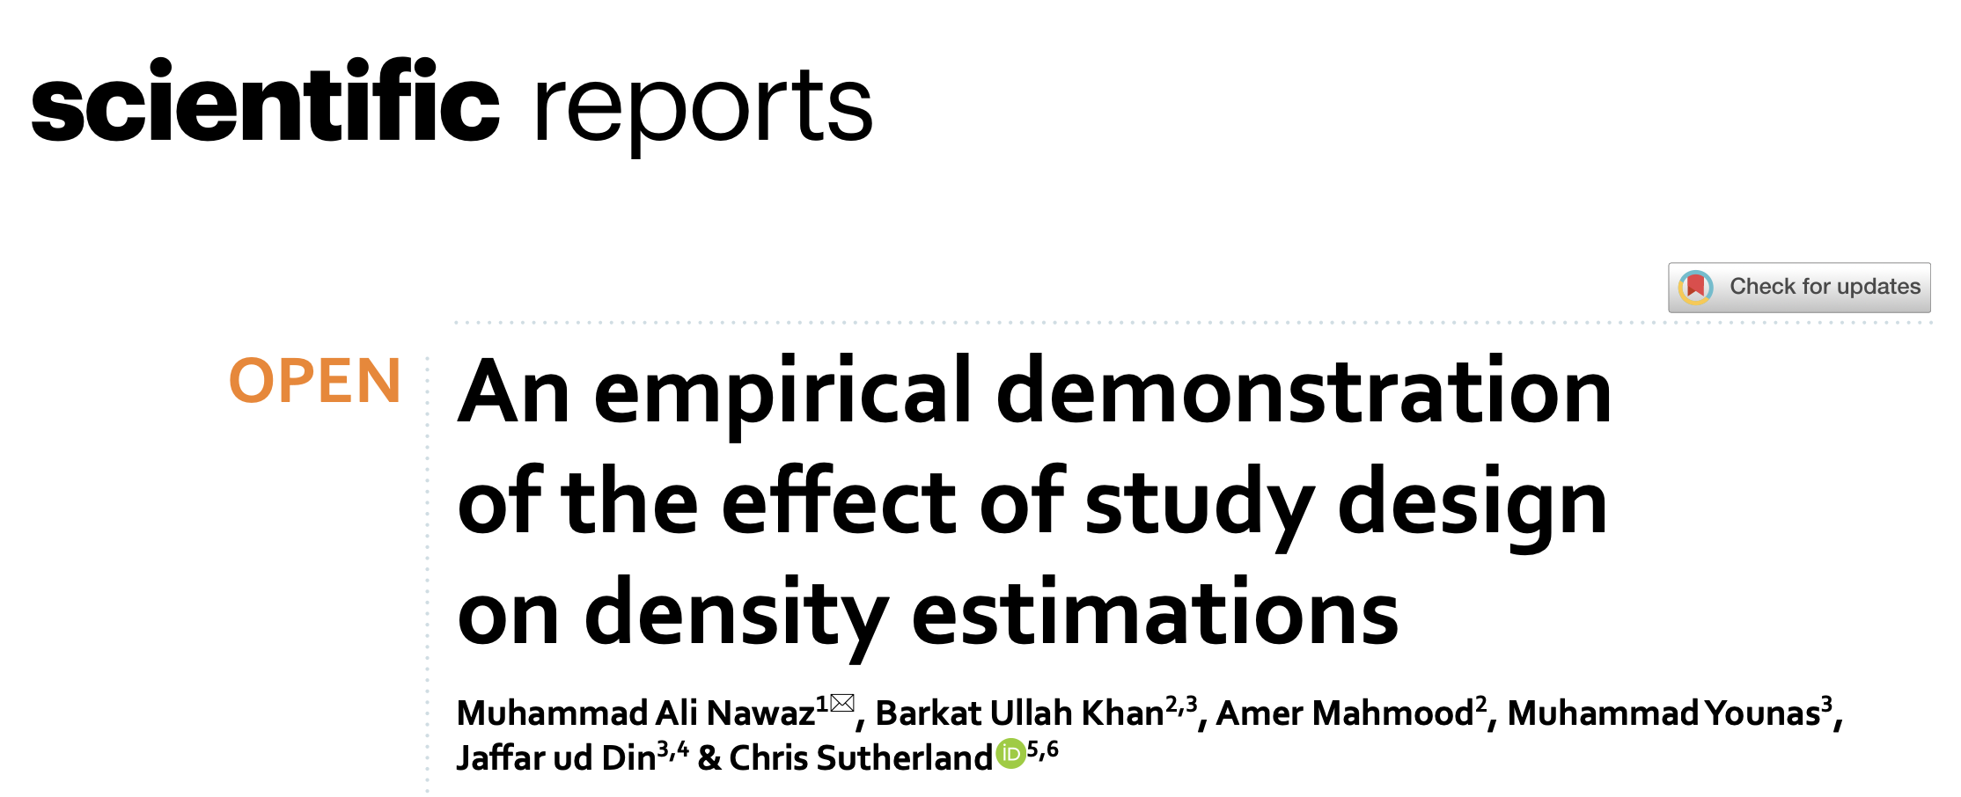
The Original Paper

Slide 4
Motivations
Snow leopards: sparce, high-interest, and individually-identifiable
Thus, low sample size and poor extensions of existing methods
Highly-mobile, yet genetically homogenous species
Current understanding of effective SCR study designs for difficult terrains and elusive wildlife is limited
Large snow leopard range in remote areas begets investigating suitability of various sampling approaches and effect on estimates
Most SCR analysis mainly estimates density and range
Based on “activity centres” and using spatial characteristics to parse out effects of detection ranges and probabilities from discrete traps
These may be better interpreted as maximum range estimates

Slide 5
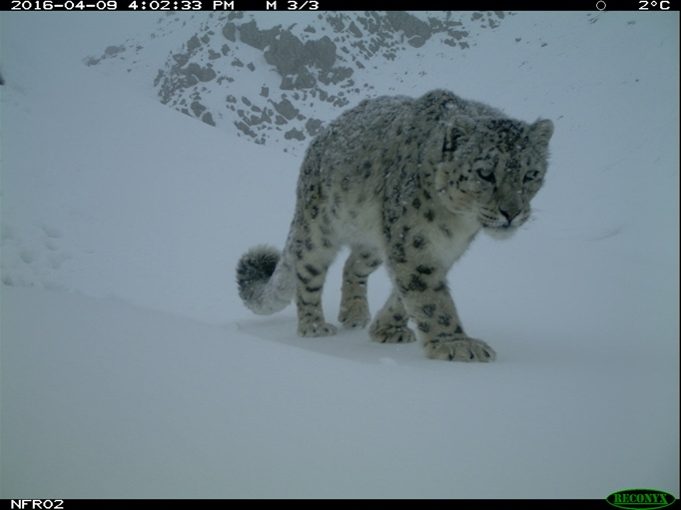
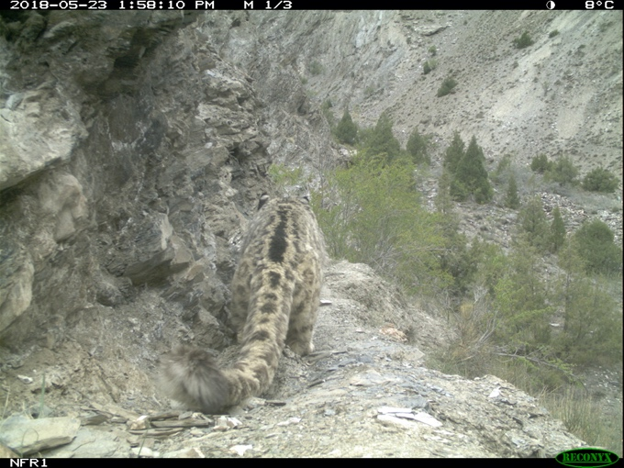
Snow Leopards Bharpu (L) and Baltoro (R)

Slide 6
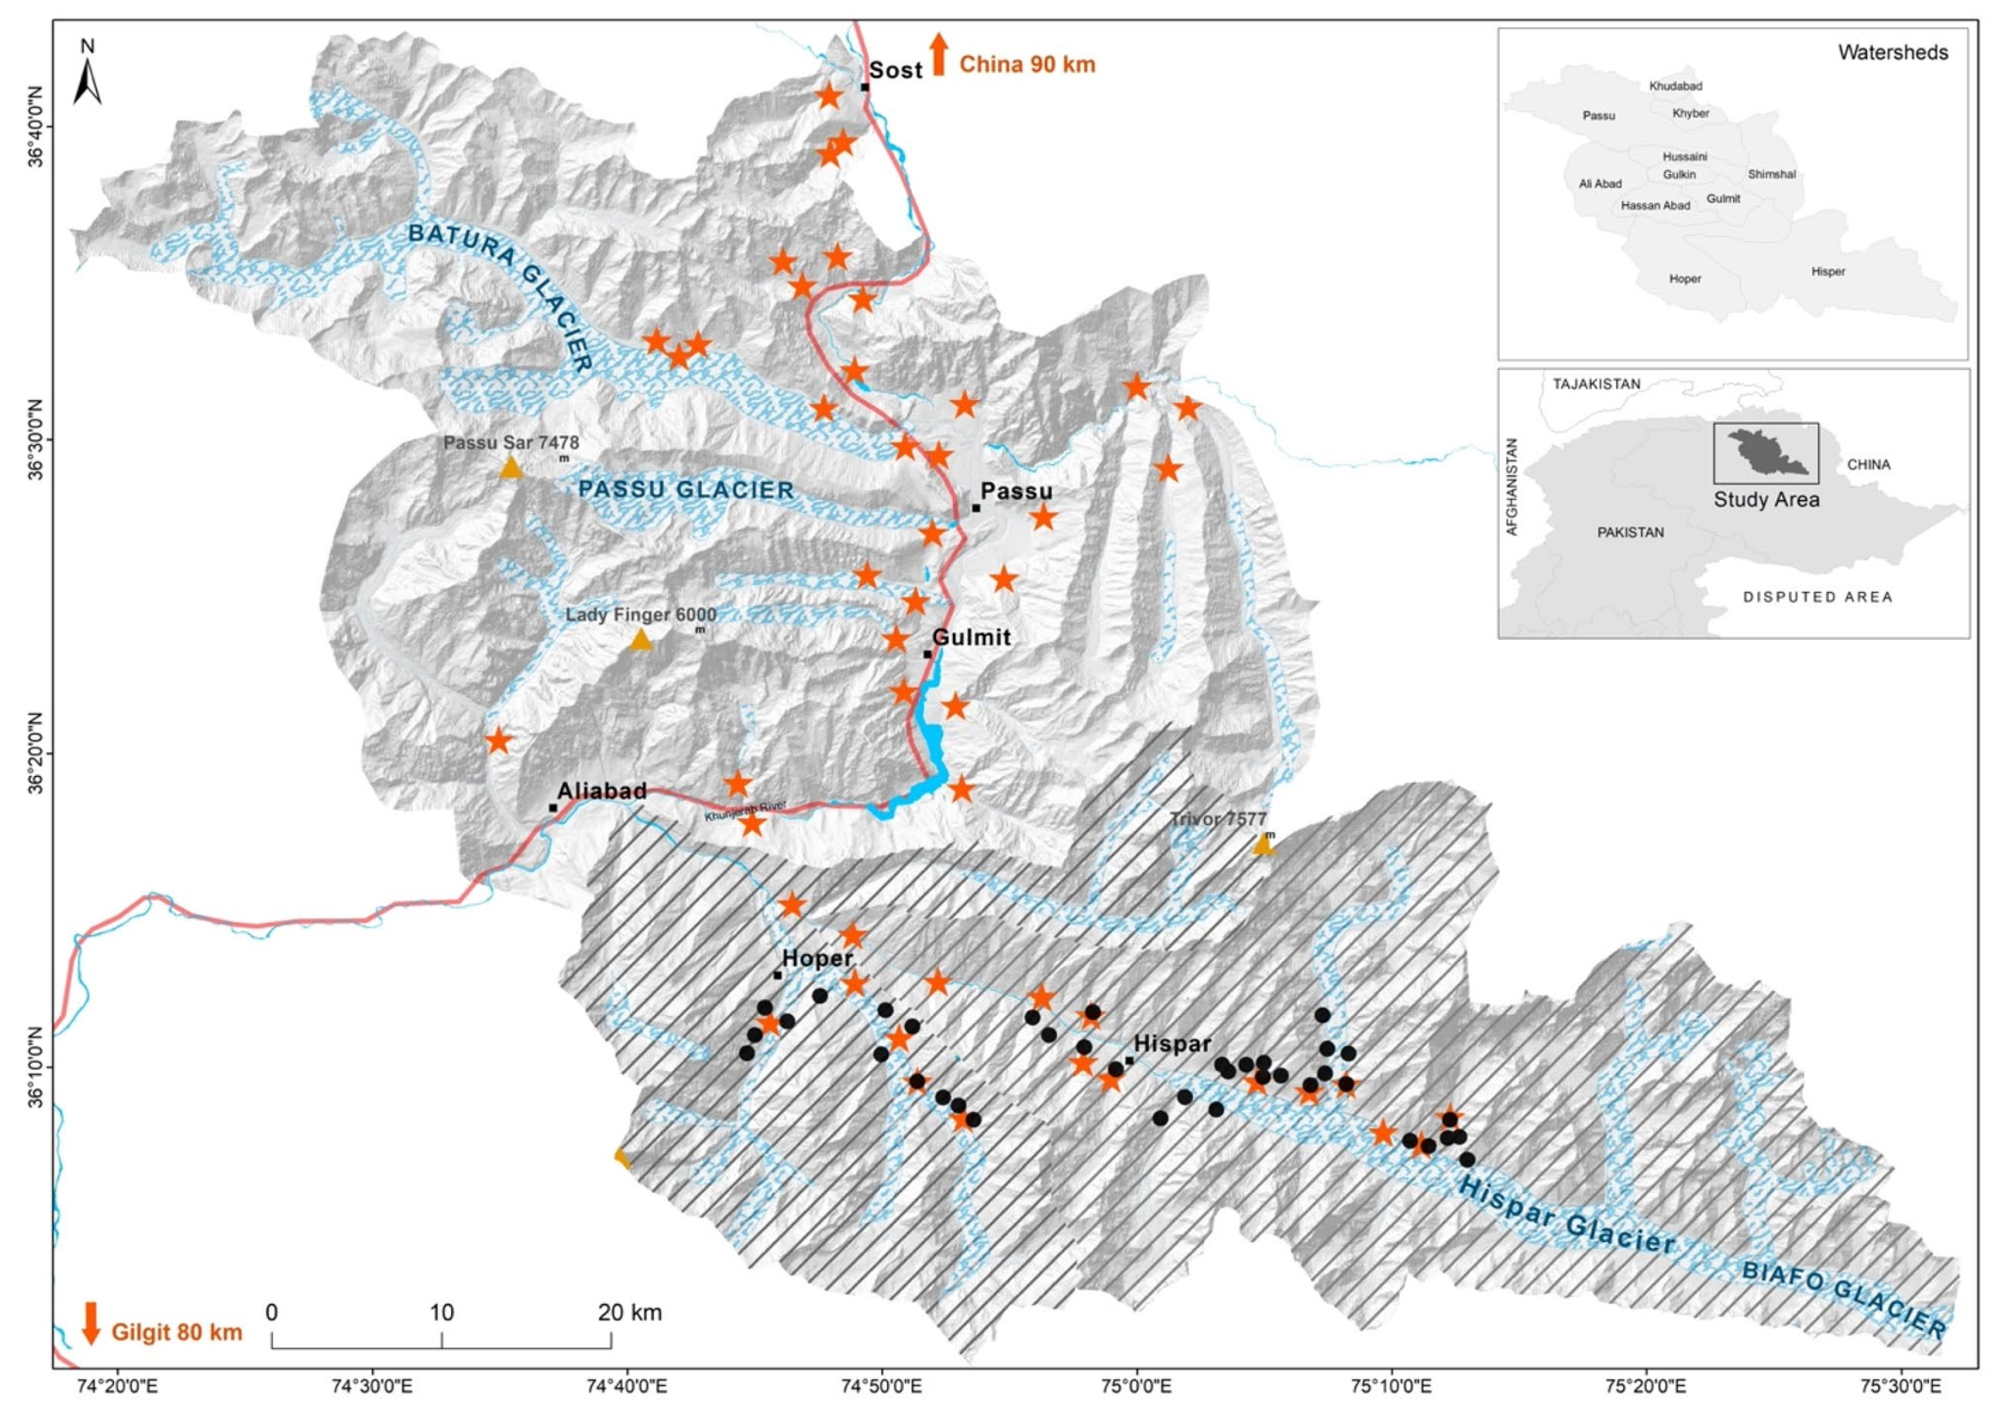
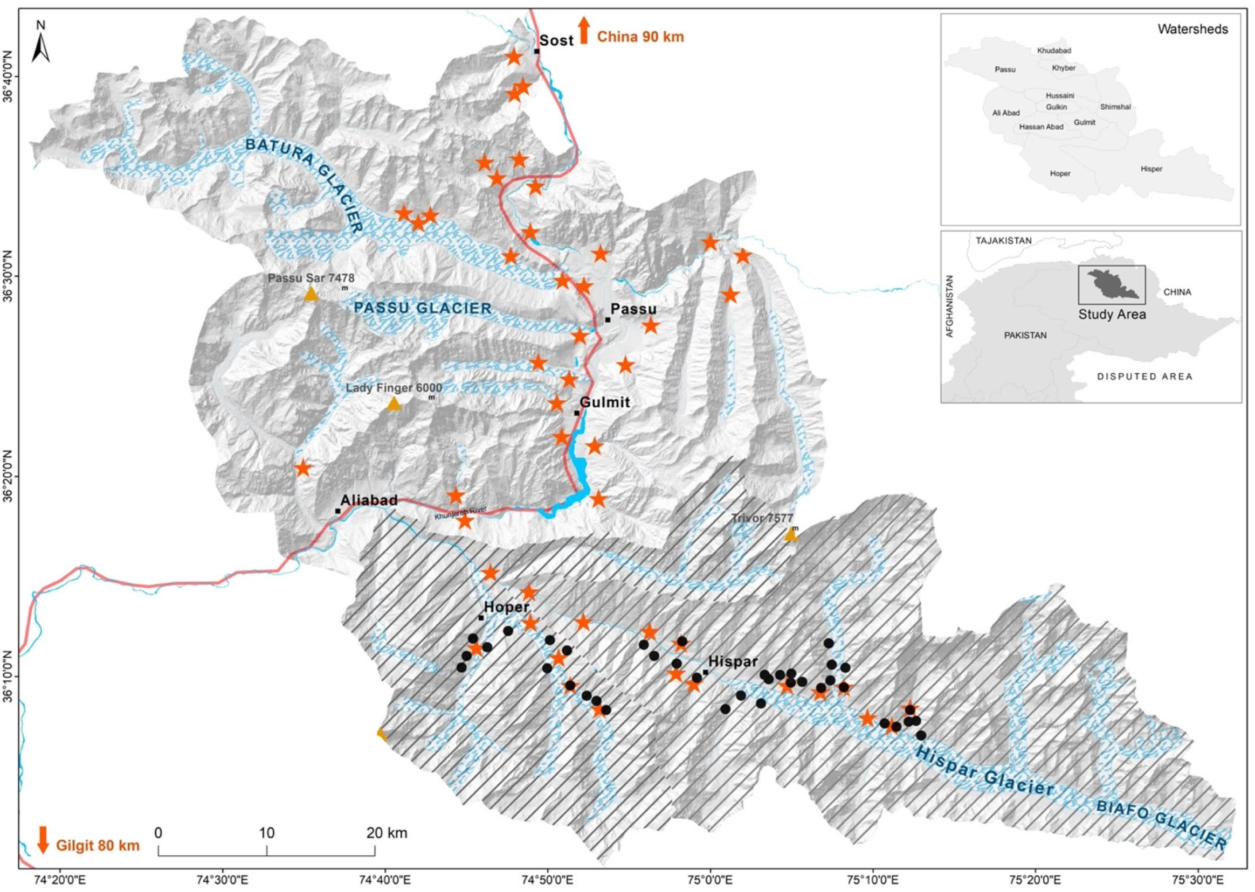
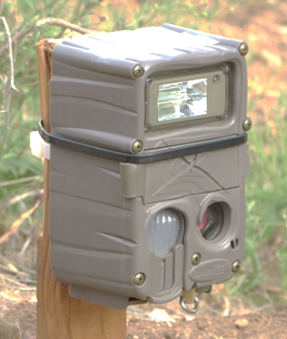
Methods: Surveying
^{Survey 1 (Compact Design):}
^{: locations of compact cameras}
^{Timeline: March to May (2016)}
^{Number: 38 cameras}
^{Spacing: 1km2}
^{Area: 253 km2}
Density: 15 cameras per 100 km2
Outcome: 27 independent capture events, 4 unique individuals
^{Survey 2 (Diffuse Design):}
: locations of diffused cameras
^{Timeline: April to June (2018)}
^{Number: 44 camera traps}
^{Spacing: 5km2}
^{Area: 2030 km2}
^{Density: 2 cameras per 100 km2}
Outcome: 21 independent capture events, and 9 unique individuals
Figure 1: Map of the study area indicating the positions of cameras using circles for compact designs and stars for diffused designs. ^{[1].}

Slide 7

Methods: State Model
SCR uses hierarchical modelling to separate out two processes:
The latent state model: what drives ecological “truth”
The observation model: accounting for imperfect observations
SCR is primarily used to estimate animal density $D$ (also activity centres, but those closely link to the observation model)
This work focusses more on the observation process, so $D$ is linearly modelled using a single covariate for survey type (session)
Crucial assumption: underlying snow leopard density does not change between sessions, so all differences must be due to survey design

Slide 8

Methods: Observation Model
Camera traps: multiple individuals at multiple sites and number of detections (count detectors)
We’re primarily interested in detections $y_{ij(k)g}$ as either 0 (undetected) or 1 (detected), across
$i=1,2,…, 13$ individuals; $j=1,2,…, 82$ camera traps; $g=1,2$ sessions (here identical to occasions $k$)
y are counts, so $y_{ijg}|s_{i} \sim Poisson\left(λ_{ijg}\right)$, where
$s_{i}$: the activity centre for individual $i$, and
$λ_{ijg}$: expected detections for individual $i$, trap $j$, and session $g$, and
Detection probability $p_{ijg}=1−exp⁡(−λ_{ijg})$
The core of SCR is estimating $λ_{ijg}$ using a detection function

Slide 9

Methods: Observation Model
The core of SCR is estimating $λ_{ijg}$ using a detection function:
$λ_{ijg}=λ_{0}×e^{\left(−\frac{{distance\left(s_{i},x_{j}\right)}^{2}}{2σ^{2}}\right)}$, where
$λ_{0}$: expected detections for individual with centre $s_{i}$ at trap $j$
$σ$: half-normal detection parameter, representing detection range
$λ_{0}$ is estimated using a Poisson GLM with an offset
$\log\left(λ_{0}\right)=α+\log{(operating days)}$, where
$α$ is a constant per-day encounter rate
$Poisson(λ_{ijg})$ multiplicatively summed (assuming independence) across all traps $j$ and sessions $g$ to estimate a likelihood

Slide 10
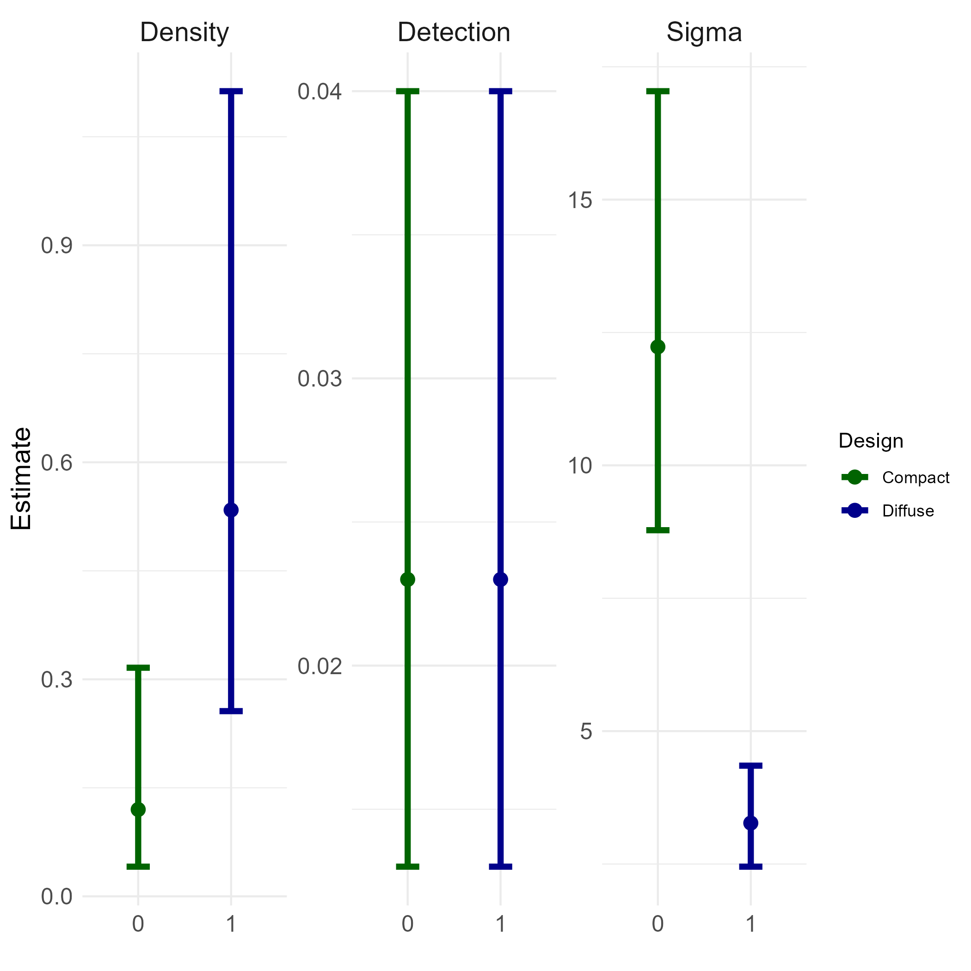
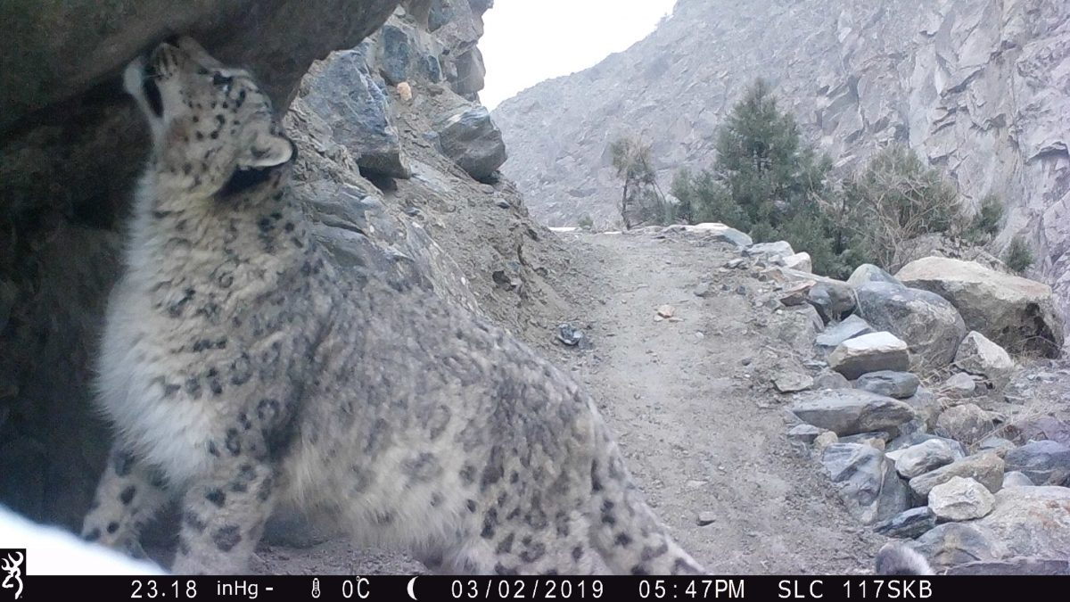
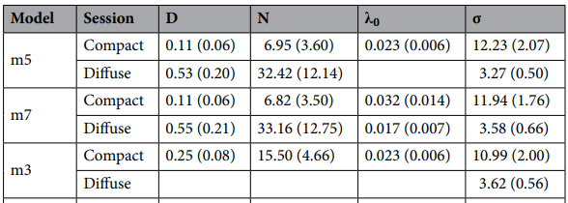
Results I:
Home range size
Compact : 2764.23 km²
Diffuse: 201.22 km²
A Snow Leopard Captured on Camera Trap in Pakistan, Snow Leopard Conservancy. (2020, March 11) ^{[3]}
Figure 2: Effect of design on SCR parameter estimates. Bars indicate 95% Confidence Intervals. ^{[1].}
Table 1: Parameter estimates of SCR. D density/100 km2 , Ν population, 0 detection probability, σ spatial scale parameter. ^{[1].}

Slide 11
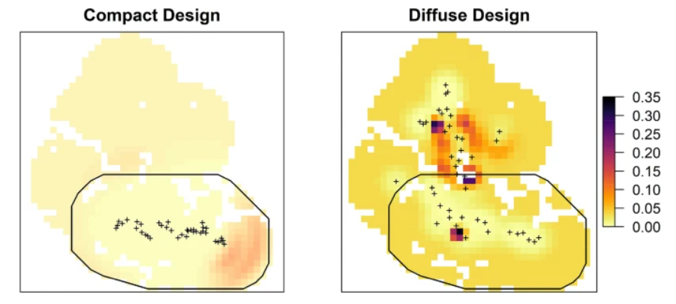
Results II:
This slide seems a bit weak????
Figure 3: Spatial pattern of snow leopard density (animals/100 km²) plus sign represents trap locations. Black polygon marks area of compact design ^{[1]}

Slide 12
No change in detection probabilities
No covariates
Separability: p0 and sigma are poorly separated and react poorly to using the same covariates
Density surfaces and closure issues may warrant more robust theoretical models
Discussion/Limitations 1

Slide 13
Good call-out of papers underestimating home range and overestimating localised densities
Animal behaviour may be an issue with small numbers of individuals: castor oil, trap-happiness, trap-shyness, and only 1 occasion
Discussion/Limitations 1

Slide 14
References (fix later)
[1] : Nawaz, M. A., Khan, B. U., Mahmood, A., Younas, M., Din, J. u., & Sutherland, C. (2021). An empirical demonstration of the effect of study design on density estimations. Scientific Reports, 11(13104). https://doi.org/10.1038/s41598-021-92668-9
[2] K2 (Mount Godwin Austen), in the Karakoram Range, viewed from the Gilgit-Baltistan district of the Pakistani-administered portion of the Kashmir region. https://www.britannica.com/place/Karakoram-Range
[3] Snow Leopard Conservancy. (2020, March 11). Using camera trap technology to monitor snow leopards [Blog post]. Retrieved from https://snowleopardconservancy.org/2020/03/11/using-camera-trap-technology-to-monitor-snow-leopards/

